Slide 1
Chapter : 6 Vitamins
Prepared by: Prof. Sanjay A. Nagdev
Department Of Quality Assurance
K.Y.D.S.C.T’s College of pharmacy

Slide 2
Vitamins are organic nutrients that are required in small quantities by organism for a variety of biochemical functions and to maintain normal growth and regulation of metabolism.
Generally vitamins are not synthesized in the body and must be supplied by the diet.

Slide 3
Classification of Vitamins

Slide 4
Fat soluble vitamins: A, D, E, and K.
Soluble in lipids and insoluble in aqueous solutions.
Importance:
Vitamin A: Formation of Visual Pigments
Vitamin D: Absorption and Deposition of Calcium and Phosphate
Vitamin E: Antioxidant
Vitamin K: Blood Clotting factor

Slide 5
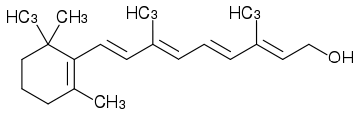
Structure of Vitamin A (Retinol):
Retinol
Sources: Fish oil (specially Shark liver oil), Carrot, Dairy products, spinach, sweet potatoes, Apricots.
Deficiency: Results in Beri-Beri and Xeropthalamia (hardening Cornea)

Slide 6
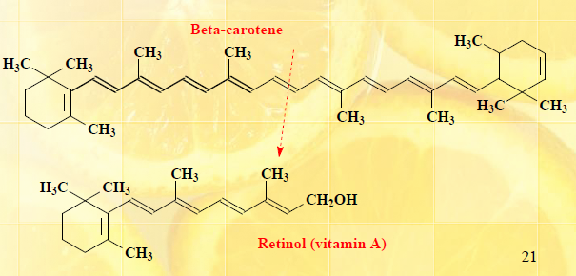
Precursor: β-Carotene
In vegetables Vitamin A exist as Pro-vitamin in the form of Yellow pigment β-Carotene.
Beta-carotenes are converted by liver enzymes to vitamin A (retinol).
β-Carotene decreases the incidence of heart attack, skin and Lung cancer.

Slide 7
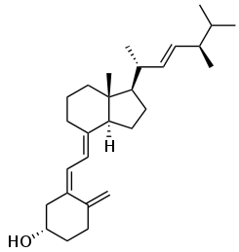
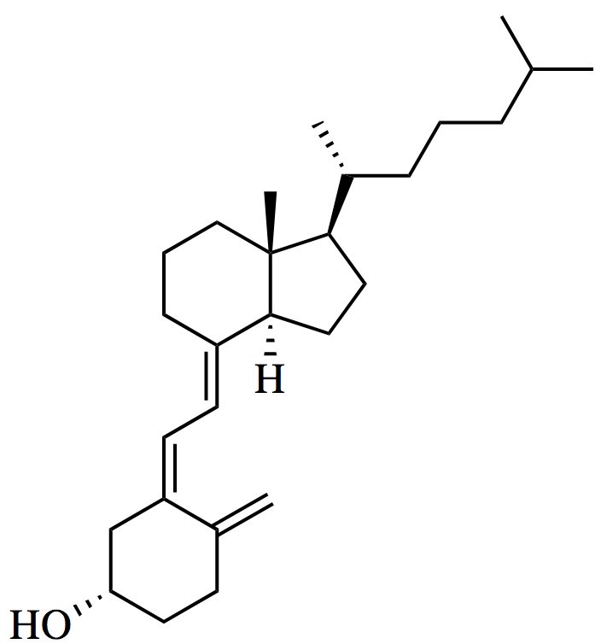
Structure of Vitamin D: (Calciferols)
Vitamin D3 (chole-calciferol) Vitamin D2 (ergo- calciferol)

Slide 8
Sources: Cod liver oil, egg, milk.
Deficiency: Ricketts and weakened bones.
Regulates the absorption of phosphorus and calcium during bone growth.

Slide 9
Structure of Vitamin E: (Tocoferols)
Uses: Antioxidant, cures Skin Diseases and burns, improves immunity etc.
Sources: green vegetables, vegetable oils (like soybean, palm and cotton seed oil. ), corn, bread, dairy products, beans etc.

Slide 10
Deficiency: results in
Anti-sterility (Infertility)
increased WBC count(Blood anemia)
Increased excretion of ribose(Sugar) in urine
Increased Concentration of DNA and RNA in Bone Marrow

Slide 11
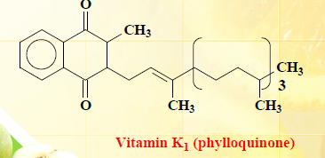
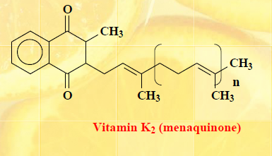
Structure of Vitamin K:
Also Called as Blood Clotting Factor.
Sources: Cereals, Carrot tops, Spinach, Fish etc.
Deficiency: Hemorrhagic disease in New Born, increased blood clotting time.

Slide 12
Water soluble vitamins

Slide 13
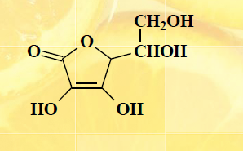
Structure of Vitamin C: (Ascorbic acid)
Ascorbic acid
Sources: found in Indian gooseberries, blueberries, citrus fruits, tomatoes, red and green vegetables.

Slide 14
Uses:
Involved in the synthesis of collagen
major component of ligaments, tendons, cartilages and skin.
Phagocyte function
Increases the production of Anti-bodies.
Involved in tyrosine metabolism.
Increases the absorption of Iron.
Prevents cataract
Deficiency:
Fatigue
personality changes
decline in psychomotor performance and motivation.
Vitamin C deficiency over 3-5 months results in symptomatic scurvy.
Scurvy leads to spongy gums, and bleeding from all mucous membranes.
In advanced scurvy there are loss of teeth.
Severe scurvy may progress to jaundice, fever and death.

Slide 15
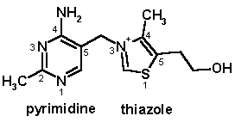
Structure Vitamin B1: (Thaimine)
Thaimine
Sources: cereals, meat, yeast, honey, nuts

Slide 16
Uses:
Co-enzyme for many enzymatic reactions
Helps in saccharine metabolism
Helps against tiredness
Deficiency:
leads to gastrointestinal upset
weakness
Degeneration of the cardiovascular system
Beri-beri

Slide 17
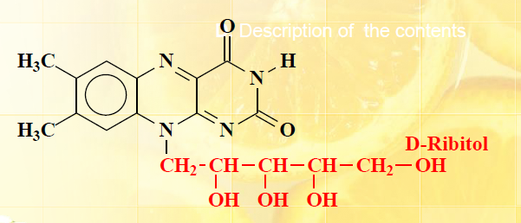
Structure of Vitamin B2: (Riboflavin)
Riboflavin
Vitamin B2 is related to an yellow colored water soluble pigment flavin
Sources: vegetables, milk, egg white, meat etc.

Slide 18
Deficiency:
affects absorption in the intestine.
The body not being able to use the vitamin.
An increase in the excretion of the vitamin from the body.
Cracked and red lips.
Inflammation of the lining of mouth and tongue.
Dry and scaling skin- keratitis, dermatitis
iron-deficiency anemia
Uses:
Coenzyme
Helps in redox reactions responsible for energy production

Slide 19
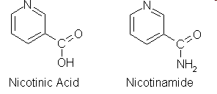
Structure of Vitamin B3: (Niacin)
Sources: beans, peanuts, milk, fish, cereals etc.

Slide 20
Deficiency:
Pellagra: dermatitis, diarrhea and dementia
Uses:
Inhibits lipolysis.
Decreases triglyceride synthesis in liver
Lowers LDL (low density lipoproteins) and cholesterol level in blood serum

Slide 21
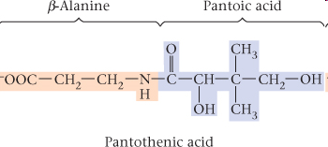
Vitamin B5: Pantothenic acid
Sources: Egg, Meat, Yeast, Milk, Grains and Vegetables

Slide 22
Uses:
Is part of coenzyme A needed for energy production as well as glucose and cholesterol synthesis.
Reduces stress
Prevents tiredness
Necessary for formation of glycogen, fatty acids, steroid hormones
Deficiency:
Fatigue
Retarded growth
Anemia
Fatty liver
Burning feet syndrome (Pain And Numbness in toes)

Slide 23
Vitamin B6 : Pyridoxine
Pyridoxine and Pyridoxal are two forms of Vitamin B6
Sources: meat, fish, vegetables, cereals etc

Slide 24
Uses:
Helps in Amino acids and protein metabolism
Maintenance of healthy brain functioning
Formation of RBC’s (hemoglobin formation)
Antibody synthesis and strengthening of immune system
maintains blood glucose within a normal range
Deficiency:
Dermatitis (skin inflammation)
Stomatitis (inflammation of the mucous lining in the mouth)
Glossitis (inflammation or infection of the tongue ).
Neurological abnormalities: Depression, confusion, and convulsions
Anemia

Slide 25
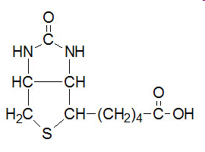
Structure of Vitamin B7: Biotin
Biotin
Sources: Meat, yeast, egg yolk, mushrooms, milk and diary products

Slide 26
Uses:
Used in fatty acid synthesis
Helps in leucine metabolism
Conversion of Pyruvate to Oxaloacetate(In TCA Cycle and glucogenolysis)
Deficiency:
Anemia
Loss of appetite
Nausea
Dermatitis
Depression
Hallucination
Muscle Pain

Slide 27
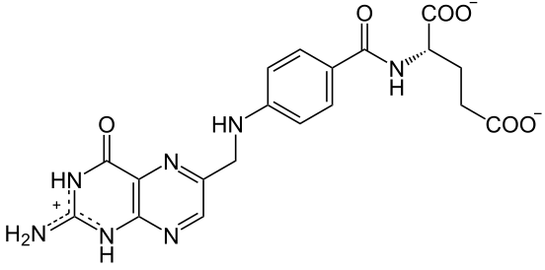
Vitamin B9: Folic Acid
Folic Acid
Sources: Green Leafy vegetables, grains, cereals, yeast and eggs.

Slide 28
Uses:
Helps in Carbon Metabolism
Required for synthesis of glycine, methionine and nucleotides
Deficiency:
Vitamin Deficiency specially observed in Pregnant women's
Decreases Purine synthesis (Impairs DNA Synthesis)
Anemia
Changes in Bone Marrow
Neural Defects in Fetus (in pregnant women)

Slide 29
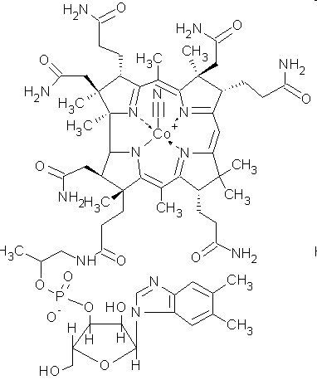
Vitamin B12: Cyanocobalamine
Sources: Milk, Curd, egg, Fish and Chicken

Slide 30
Uses:
Formation of red blood cells
Maintenance of neuro tissue
Cures neuro diseases and anemia
Deficiency:
Pernicious anemia (low hemoglobin level and decreased erythrocytes)
Insufficient production of gastric fluid
Neural Degeneration
Paresthesia (Numbness and tingling of fingers and toes)
Confusion and loss of memory

Slide 31
Vitamin | Required dietary Values
A (retinol) | 1-3 mg/day
D (calciferol) | 10 mg/day
E (Tocoferol) | 8-10 mg/day
K | 70-140 μg/day
B1 (thiamine) | 1-1.5 mg/day
B2 (riboflavin) | 1.2-1.7 mg/day
B3 (niacin, niacinamide) | 15-20mg/day
B5 (Pantothenic acid) | 5-10 mg/day
B6 (pyridoxine) | 2-2.2 mg /day
B7(Biotin) | 100-300 mg/day
B9 (Folic Acid) | 200 μg/day
B12 (Cynocobalamine) | 0.5-4 μg/day
C (Ascorbic acid) | 60-70 mg/day

