Slide 1
Chapter 7: Carbohydrate Metabolism
By
Prof. Sanjay A. Nagdev
Dept of Quality Assurance
K.Y.D.S.C.T’s College of Pharmacy Sakegaon

Slide 2
Metabolism:
Thousands of chemical reactions are taking place inside a cell in an organized, well coordinated and purposeful manner, all these reactions are called as METABOLISM.
TYPES:
Catabolism : is the set of metabolic pathways that breaks down complex molecules into smaller units that are oxidized to release energy.
Anabolism: the synthesis of complex molecules in living organisms from simpler ones together with the storage of energy.

Slide 3
Glycolysis or Embden-Meyerhof pathway or E.M.Pathway
Definition: It is defined as sequence of reactions of glucose to lactate & pyruvate with the production of ATP.
It is derived from Greek word glycose -sweet or sugar, lysis- dissolution/breakdown.
Salient features:
1) Takes place in all cells of the body.
2) Site: cytoslic fraction of the cell.
3) Lactate – end product – anaerobic condition.
4) Pyruvate– end product of aerobic condition.
6) Very essential for brain – dependent on glucose for energy.

Slide 4
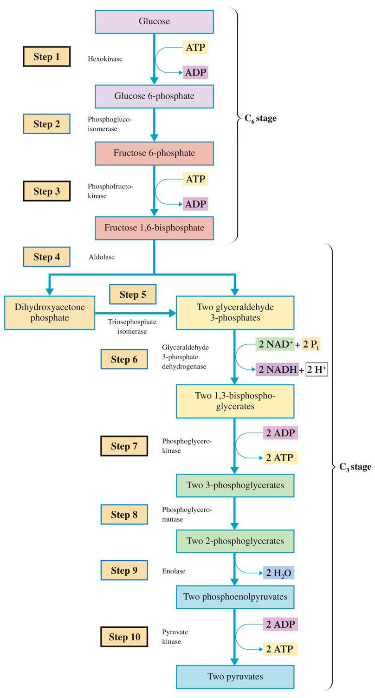

Slide 5
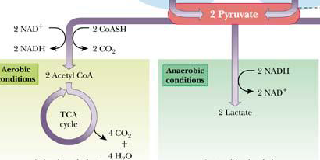

Slide 6
Step 1: Formation of glucose-6-phosphate: catalyzed by Hexokinase and Energy needed is derived from ATP hydrolysis
Step 2: Formation of Fructose-6-phosphate: by Enzyme Phosphoglucoisomerase
Step 3: Formation of Fructose 1,6-bisphosphate: by Enzyme Phosphofructokinase
Step 4: Formation of Triose Phosphates: C6 species is split into two C3 species by Enzyme Aldolase
Step 5: Isomerization of Triose Phosphates DHAP is isomerized to glyceraldehyde 3-phosphate by Enzyme Triosephosphate isomerase
Step 6: Formation of 1,3-bisphosphoglycerate : Glyceraldehyde 3-phosphate is oxidized and phosphorylated by Enzyme Glyceraldehyde-3-phosphate dehydrogenase

Slide 7
Step 7: Formation of 3-bisphosphoglycerate by Enzyme: Phosphoglycerokinase
Step 8: Formation of 2-phosphoglycerate i.e. Isomerization of 3-phosphoglycerate to 2-phosphoglycerate by Enzyme Phosphoglyceromutase
Step 9: Formation of Phosphoenolpyruvate by Enzyme: Enolase
Step 10: Formation of Pyruvate : by Enzyme Pyruvate kinase

Slide 8
Gluconeogenesis:
The synthesis of glucose from non-carbohydrate substrates is known as gluconeogenesis
Major substrate/precursors : lactate, pyruvate, glycogenic amino acids, propionate & glycerol.
Takes place in liver

Slide 11
TCA or Kreb’s Cycle or Citric Acid Cycle
Citric acid cycle:
A series of biochemical reactions in which the acetyl portion of acetyl CoA is oxidized to carbon dioxide
Takes place in the mitochondria
Named after Hans Krebs who elucidated this pathway in 1937

Slide 12
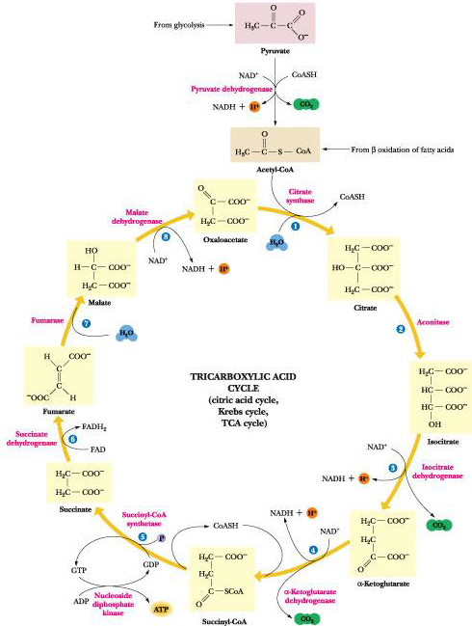

Slide 13
1) Formation of citrate : Condensation of acetyl CoA and oxaloacetate catalysed by citrate synthase.
2) & 3) Citrate is isomerized to isocitrate by aconitase
4) & 5) Formation of α ketoglutarate : enzyme isocitrate dehydrogenase.
6) Conversion of α-ketoglutarate to succinyl CoA :by α ketoglutarate dehydrogenase.
7)Formation of succinate : enzyme succinyl coA Synthetase
8)Conversion of succinate to fumarase : enzyme succinate dehydrogenase
9)Formation of malate : enzyme fumarase
10)Conversion of malate to oxaloacetate : enzyme malate dehydrogenase.

Slide 14
Pentose Phosphate pathway or
(Hexose Monophosphate shunt)
Alternative route for metabolism of glucose
It occurs in cytosol
Pentose or its derivatives are useful for the synthesis of nucleic acids and nucleotides.

Slide 16
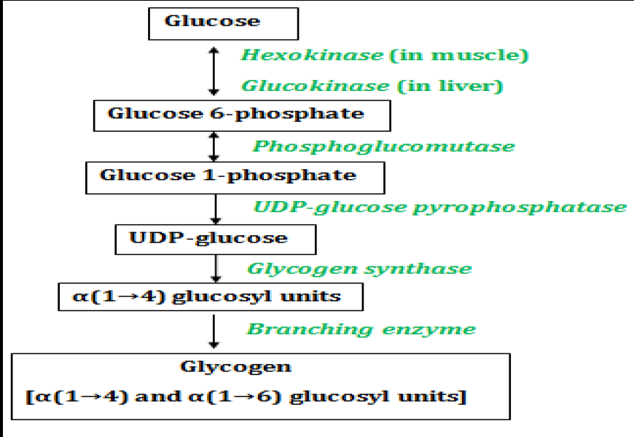
Glycogenesis

Slide 17
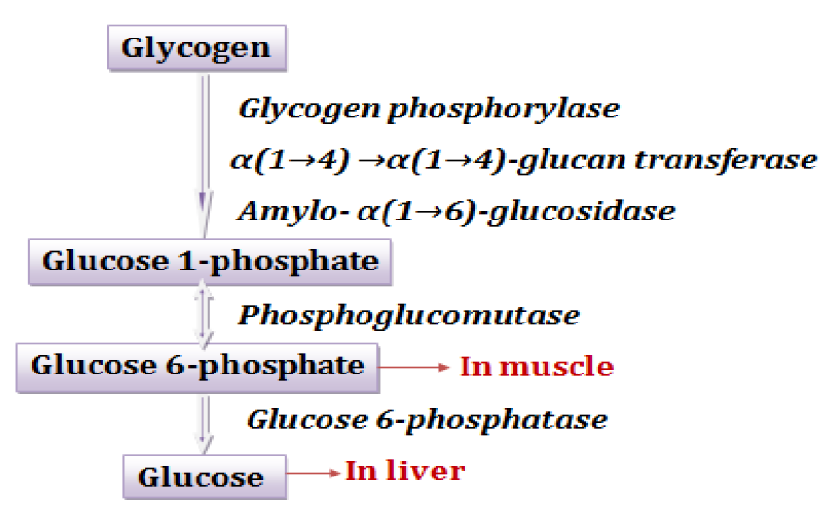
Glycogenolysis

