Slide 1
Chapter 4: Proteins
By
Prof. Sanjay A. Nagdev
Dept of Quality Assurance
K.Y.D.S.C.T’s College of Pharmacy Sakegaon

Slide 2
Introduction
DEFINITION:
Class of nitrogenous organic compounds which have large molecules composed of one or more long chains of amino acids and are an essential part of all living organisms, especially as structural components of body tissues, enzymes and antibodies.
Protein is derived from Greek word Proteios means Holding the first Place
Most abundant organic molecules of the living system
Its fundamental basis of structures and function of life.
50 % of dry weight of every cell
Proteins are polymer of L α-amino acids.
300 different amino acids occur in nature –only 20 as standard amino acids.
21st amino acid added is Selenocysteine

Slide 3
Elemental composition of proteins:
Carbon: 50-55%
Hydrogen: 6.0-7.3%
Oxygen : 19-24%
Nitrogen: 13-19%
Sulfur: 0-14%
Beside these elements proteins also contain phosphorus, iron, copper, manganese, zinc etc

Slide 4
Biomedical importance of proteins:
Proteins are the main structural components of the cytoskeleton.
Bio-chemical catalysts known as enzymes are proteins.
Proteins known as immunoglobulin's serve as the first line of defense against bacterial and viral infections.
Several hormones are protein in nature.
Structural proteins like actin and myosin are contractile proteins and help in the movement of muscle fibre.
Some proteins present in cell membrane, cytoplasm and nucleus of the cell act as receptors.
The transport proteins carry out the function of transporting specific substances either across the membrane or in the body fluids.

Slide 5
Classification: Proteins are classified on the basis of
Chemical nature and solubility
Simple
Conjugates
Derived
Function
Structural
Enzyme or catalytic
Transport
Hormonal
Contractile
Storage
Genetic
Defense
Receptor
Nutritional Importance
Complete
Partially incomplete
Incomplete

Slide 6
Functions of proteins
Proteins perform a great variety of specialized and essential functions in living cells and these functions are broadly grouped as Static (Structural) and Dynamic functions
1. Structural Functions: Certain proteins provides Structure and strength to the body
e.g. Collagen, elastin and α-keratin
2. Dynamic functions: it means acting as
enzymes
hormones
blood clotting factor
immunoglobulin's
membrane receptors etc

Slide 7
Peptides and Proteins
The chains containing less than 50 amino acids are called “peptides”
while those containing greater than 50 amino acids are called “proteins”.
Peptides containing more than 10 amino acids are referred as polypeptide
Peptide bond formation:
α-carboxyl group of one amino acid forms a covalent peptide bond with α-amino group of another amino acid by removal of a molecule of water.

Slide 8
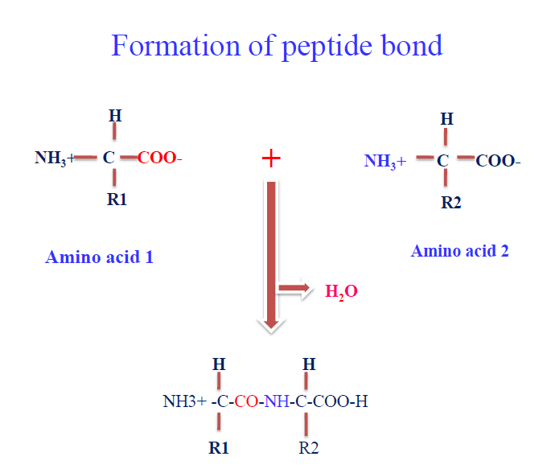

Slide 9
Structure of proteins
Proteins have different level of organization:
Primary structure: linking amino acid residues in a polypeptide chain
Secondary structure: stable arrangements of amino acid residues giving rise to recurring structural patterns into geometrically ordered units; twisting resulting in α-helix or pleated
Tertiary structure: the three-dimensional assembly of secondary structural units to form larger functional units
Quaternary structure: It’s the arrangement in space of protein having two or more polypeptide subunits

Slide 10
